Slide 1

Welcome to the Qiskit Fall Fest 2024!

Slide 2

The Qiskit Fall Fest is a massive event, featuring thousands of students worldwide who are all learning about quantum computing and Qiskit. As part of the Qiskit Fall Fest, IBM Quantum has created a series of notebooks to work through, which all include coding challenges and Qiskit tutorials.
Qiskit Fall Fest 2024

Slide 3

Graded Notebook 3: The Transpiler
Qiskit Fall Fest 2024
Difficulty: 3/5
Estimated Time: 75 minutes

Slide 4


Qiskit Fall Fest 2024
CONTENTS
Prologue - What is the transpiler?
Transpile with Preset Pass Managers
Optimization levels
Optimization level = 0
Optimization level = 1
Optimization level = 2
Optimization level = 3
Transpiler Stage Details with Options
Init stage
Layout Stage
Routing Stage
Translation Stage
Ecosystem and Qiskit Transpiler Plugin

Slide 5





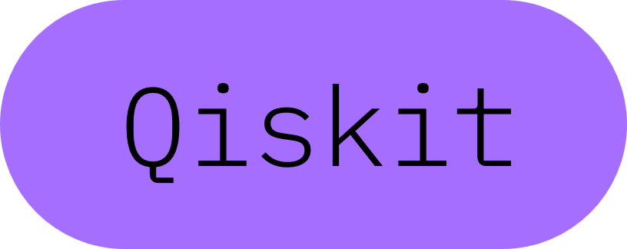

Setup
Install Qiskit and relevant packages-
Save API Token-
%pip install qiskit[visualization] %pip install qiskit_ibm_runtime %pip install qiskit_aer %pip install qiskit-transpiler-service %pip install graphviz %pip install git+https://github.com/qiskit-community/Quantum-Challenge-Grader.git
%set_env QXToken=deleteThisAndPasteYourTokenHere # Make sure there is no space between the equal sign and the beginning of your token

Slide 6
Setup
Imports-
Setup the grader-
from qiskit.circuit.random import random_circuit from qiskit.circuit.library import XGate, YGate from qiskit_ibm_runtime.fake_provider import FakeTorino, FakeOsaka from qiskit_ibm_runtime import QiskitRuntimeService, SamplerV2 as Sampler from qiskit.transpiler import InstructionProperties, PassManager from qiskit.transpiler.preset_passmanagers import generate_preset_pass_manager from qiskit.visualization import plot_distribution from qiskit_aer import AerSimulator from qiskit.transpiler.preset_passmanagers.plugin import list_stage_plugins from qiskit.visualization import plot_circuit_layout import matplotlib.pyplot as plt import numpy as np
from qc_grader.challenges.fall_fest24 import ( grade_lab3_ex1, grade_lab3_ex2, grade_lab3_ex3, grade_lab3_metaphors )

Slide 7









What is the transpiler?
Transpilation is the process of taking a given input circuit and rewriting it to an equivalent circuit for a specific quantum device, and/or to optimize the circuit for execution on a real quantum system.
Adapt circuits to different quantum hardware by considering:
Basis gate sets
Quantum chip topology
Timing constraints
Goal: Optimize circuits for best performance on noisy quantum hardware by reducing noise effects.
Key Components:
PassManager: A collection of one or more passes (circuit transformations).
StagedPassManager: Orchestrates the order and execution of PassManagers, optimizing the pipeline.

Slide 8

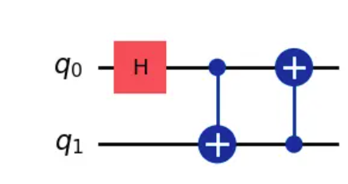
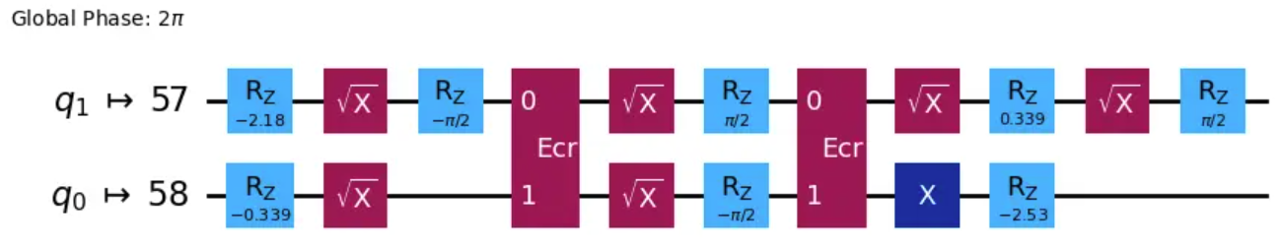
For example: the process of transpilation can take a simple looking circuit that contains your instruction.
transform it to provide the circuit you want, but by only using the basis gates or instructions that a given quantum computer is able to accept.

Slide 9
The six stages
Qiskit provides users the standard six stages of compilation flows with four pre-built transpilation pipelines.
Init: Validates and converts multi-qubit gates to single- and two-qubit gates.
Layout: Maps virtual qubits to physical qubits on the backend.
Routing: Adds gates to ensure compatibility with the backend’s connectivity.
Translation: Translates gates to the backend’s basis set.
Optimization: Optimizes the circuit for reduced depth and performance.
Scheduling: Applies hardware-aware scheduling passes

Slide 10
Exercise 1:
Your Task: Please match the description of what happens in each stage with the corresponding transpilation stage name in the code cell below.
A. This stage centers around reducing the number of circuit operations and the depth of circuits with several optimization options.
B. This stage inserts the appropriate number of SWAP gates in order to execute the circuits using the selected layout.
C. This stage is used to translate any gates that operate on more than two qubits, into gates that only operate on one or two qubits.
D. This stage executes a sequence of gates, a one-to-one mapping from the "virtual" qubits to the "physical" qubits in an actual quantum device.
E. This pass can be thought of as explicitly inserting hardware-aware operations like delay instructions to account for the idle time between gate executions.
F. This stage translates the gates specified in a circuit to the native basis gates of a specified backend.
HINT:The answer will always be a single capital letter with quotation marks. For example: "A"

Slide 11
Exercise 1:
ans = {} # Place the correct letter next to the corresponding stage, inside a parenthesis # example: ans["test"] = "M" ans["init"] = ans["layout"] = ans["routing"] = ans["translation"] = ans["optimization"] = ans["scheduling"] =
# Submit your answer using following code grade_lab3_ex1(ans)

Slide 12
Transpile with preset pass managers
What is a (staged) pass manager?
A pass manager stores a list of transpiler passes and executes them on a circuit. You can create one by initializing a PassManager with passes, then use the run method to apply it to a circuit.
A StagedPassManager is a higher-level abstraction, consisting of multiple pass managers, each representing a discrete stage in the transpilation process. This allows for more structured, stage-based transpilation.
Preset Passmanagers
Preset Passmanagers (`qiskit.transpiler.preset_passmanagers`) contains functions to generate preset pass managers, which are instances of StagedPassManager. These are used to apply circuit transformations at various optimization levels in a predefined transpiling pipeline.

Slide 13
Exercise - Metaphors
Your Task: Think of the StagedPassManager as the conductor in an orchestra, the PassManagers as the different instrument sections, and the Pass objects as the individual musicians. Similarly come up with your own metaphor for the relationship between a StagedPassManager, a PassManager, and a pass.
# Submit your answer using following code ans = "leave your metaphors here in one sentence!“
grade_lab3_metaphors(ans)

Slide 14

Optimization levels
In Qiskit, generate_preset_pass_manager quickly creates a standalone PassManager with customizable optimization levels.
The required optimization_level argument controls how much effort the transpiler spends on optimizing circuits. This argument is an integer taking one of the values 0, 1, 2, or 3.
Higher optimization levels generate more optimized circuits at the expense of longer compile times, and vice versa.

Slide 15
Utility function
Since the goal of transpiling is to improve the actual execution performance of the circuit, here we provide a function that measures the performance of the translated circuit.
Function description: The function scoring should receive the transpiled circuit, its final layout and its target backend as its inputs.The function should then return a circuit score. The closer the score is to 0, the better.
def scoring(qc, backend): gate_count = qc.count_ops() if "cz" not in gate_count: gate_count["cz"] = 0 score = gate_count['cz'] * 10 score += gate_count['sx'] * 1 score += gate_count['rz'] * 1 return score
**Please use `FakeTorino` from the `qiskit-ibm-runtime` package for this whole lab.

Slide 16
Utility function
let's finish setting up everything we need to properly test our circuit on a fake backend.
To test the performance of each optimization level, call `FakeTorino` and save it as `backend`.
### Create a random circuit ## DO NOT CHANGE THE SEED NUMBER seed = 10000 ## Create circuit num_qubits = 6 depth = 4 qc = random_circuit(num_qubits,depth,measure=False, seed=seed) qc.draw('mpl')
#`FakeTorino` has the connectivity and noise features of ibm_torino, which is the latest IBM Quantum backend with a Heron processor.
backend = FakeTorino()

Slide 17
Utility function
We are going to walk through running all four optimization levels and then compare our results at the end. In order to do this, we will create a few arrays to hold the information as we work, then use them later on.
circuit_depths = { 'opt_lv_0': None, 'opt_lv_1': None, 'opt_lv_2': None, 'opt_lv_3': None, } gate_counts = { 'opt_lv_0': None, 'opt_lv_1': None, 'opt_lv_2': None, 'opt_lv_3': None, } scores = { 'opt_lv_0': None, 'opt_lv_1': None, 'opt_lv_2': None, 'opt_lv_3': None, }

Slide 18
Optimization level = 0
Optimization level 0 is intended for device characterization experiments and, as such, only maps the input circuit to the constraints of the target backend without performing any optimizations. It performs layout/routing with TrivialLayout where it selects the same physical qubit numbers as virtual and inserts SWAPs to make it work using StochasticSwap.
# Make a pass manager with our desired optimization level and backend pm_lv0 = generate_preset_pass_manager(backend=backend, optimization_level=0, seed_transpiler=seed) # Run for our random circuit tr_lv0 = pm_lv0.run(qc) # uncomment the next line to draw circuit #tr_lv0.draw('mpl', idle_wires=False, fold=60)
# optimization_level=0 is performing a basic gate decomposition by using basis gates of the backend and mapping logical qubits to physical qubits with a same order of number.

Slide 19
Exercise 2(Start)
Your Task: Find the circuit depth of the random circuit, the sum of the total gate number, and compute the performance score of this circuit using `scoring`. Use the provided code to save each of these results to our previously made array.
### Your code here ### circuit_depths['opt_lv_0'] = gate_counts['opt_lv_0'] = scores['opt_lv_0'] = ### Don't change code after this line ### print("Optimization level 0 results") print("====================") print("Circuit depth:", circuit_depths['opt_lv_0']) print("Gate count:", gate_counts['opt_lv_0']) print("Score:", scores['opt_lv_0'])

Slide 20
Optimization level = 1
Optimization level 1 performs a light optimization. Here's what that means:
Layout/Routing: Layout is first attempted with TrivialLayout. If additional SWAPs are required, a layout with a minimum number of SWAPs is found by using SabreSWAP , then it uses VF2LayoutPostLayout to try to select the best qubits in the graph.
InverseCancellation
1Q gate optimization
# Make a pass manager with our desired optimization level and backend pm_lv1 = ### your code here ### # Run for our random circuit tr_lv1 = pm_lv1.run(qc) # uncomment the next line to draw circuit #tr_lv1.draw('mpl', idle_wires=False, fold=60)

Slide 21
Optimization level = 1
let's once again find the circuit depth of the random circuit, the sum of the total gate number, and compute the performance score of this circuit using scoring.
### Your code here ### circuit_depths['opt_lv_1'] = gate_counts['opt_lv_1'] = scores['opt_lv_1'] = ### Don't change code after this line ### print("Optimization level 1 results") print("====================") print("Circuit depth:", circuit_depths['opt_lv_1']) print("Gate count:", gate_counts['opt_lv_1']) print("Score:", scores['opt_lv_1'])

Slide 22
Optimization level = 2
Optimization level 2 performs a medium optimization, which means:
Layout/Routing: Optimization level 1 (without trivial) + heuristic optimized with greater search depth and trials of optimization function. Because TrivialLayout is not used, there is no attempt to use the same physical and virtual qubit numbers.
CommutativeCancellation
# Make a pass manager with our desired optimization level and backend pm_lv2 = ### your code here ### # Run for our random circuit tr_lv2 = pm_lv2.run(qc) # uncomment the next line to draw circuit #tr_lv2.draw('mpl', idle_wires=False, fold=60)

Slide 23
Optimization level = 2
let's measure the performance of transpiling.
### Your code here ### circuit_depths['opt_lv_2'] = gate_counts['opt_lv_2'] = scores['opt_lv_2'] = ### Don't change code after this line ### print("Optimization level 2 results") print("====================") print("Circuit depth:", circuit_depths['opt_lv_2']) print("Gate count:", gate_counts['opt_lv_2']) print("Score:", scores['opt_lv_2'])

Slide 24
Optimization level = 3
Optimization level 3 performs a high optimization:
Optimization level 2 + heuristic optimized on layout/routing further with greater effort/trials
Resynthesis of two-qubit blocks using Cartan's KAK Decomposition
Unitarity-breaking passes:
OptimizeSwapBeforeMeasure: Remove swaps in front of measurements by re-targeting the classical bit of the measure instruction to avoid SWAPs
RemoveDiagonalGatesBeforeMeasure: Remove diagonal gates (like RZ, T, Z, etc.) before a measurement. Including diagonal 2Q gates.
pm_lv3 =### your code here ### tr_lv3 =### your code here ### # uncomment to draw circuit #tr_lv3.draw('mpl', idle_wires=False, fold=60)

Slide 25
Optimization level = 3
### Your code here ### circuit_depths['opt_lv_3'] = gate_counts['opt_lv_3'] = scores['opt_lv_3'] = ### Don't change code after this line ### print("Optimization level 3 results") print("====================") print("Circuit depth:", circuit_depths['opt_lv_3']) print("Gate count:", gate_counts['opt_lv_3']) print("Score:", scores['opt_lv_3'])
let's graph how much the depth of the circuit, the number of gates, and the evaluation score have changed according to each optimization level.
colors = ['#FF6666', '#66B2FF'] ax = ["opt_lv_0", "opt_lv_1", "opt_lv_2", "opt_lv_3"] fig, (ax1, ax2, ax3) = plt.subplots(3, 1, figsize=(10, 12))

Slide 26
Optimization level = 3
# Plot 1: Circuit Depth ax1.semilogy(ax, [circuit_depths[key] for key in ax],'o-',markersize=9, color='#FF6666', label="Depth") ax1.set_xlabel("Optimization Level", fontsize=12) ax1.set_ylabel("Depth", fontsize=12) ax1.set_title("Circuit Depth", fontsize=14) ax1.legend(fontsize=10) # Plot 2: Total Number of Gates ax2.semilogy(ax, [gate_counts[key] for key in ax],'^-',markersize=9, color='#66B2FF', label="Counts") ax2.set_xlabel("Optimization Level", fontsize=12) ax2.set_ylabel("Gate Count", fontsize=12) ax2.set_title("Gate Count", fontsize=14) ax2.legend(fontsize=10) # Plot 3: Score of Transpiled Circuit ax3.semilogy(ax, [scores[key] for key in ax],'*-',markersize=9, label="Score") ax3.set_xlabel("Optimization Level", fontsize=12) ax3.set_ylabel("Score", fontsize=12) ax3.set_title("Score", fontsize=14) ax3.legend(fontsize=10) fig.tight_layout() plt.show()

Slide 27
Exercise 2(Finish)
Your Task: Above you did a great amount of work to construct your different pass managers, test them, and save information about each one to it's corresponding array. You graphed that information to visibly compare your results. Now, submit all four pass managers to the grader.
# Submit your answer using following code answer = [pm_lv0, pm_lv1, pm_lv2, pm_lv3] grade_lab3_ex2(answer)

Slide 28
Transpiler stage details with options
Key features of the Qiskit SDK v1.0 transpiler is the ease with which users can build and configure a custom passmanager.
Custom Pass Manager: Users can choose from six standard passes along with various optimization levels as well as select an option or plug-in for each pass.
StagedPassManager: Allows creation of pass managers with any number of passes.
Pass Manager as Plugin: Create and deploy new pass managers as plugins. Other users can implement these pass managers in their projects.

Slide 29
Init stage
This first stage does very little by default and is primarily useful if you want to include your own initial optimizations. This stage translates multi-qubit gates into single- and two-qubit gates.
If you specify an argument at this stage for the qubits you want to use, that value overrides all the passes that could change it.
Without extra plugins, only default options exist. This process includes several transpiler pass plugins depending on the optimization_level.
list_stage_plugins("init") print("Plugins run by default init stage") print("=================================") for i in range(4): print(f"\nOptimization level {i}:") pm = generate_preset_pass_manager(backend=backend, optimization_level=i, init_method="default", seed_transpiler=1000) for task in pm.init.to_flow_controller().tasks: print(" -", type(task).__name__)

Slide 30
Table of each plugin's API docs
Plugin | Description | API docs link
UnitarySynthesis | Synthesize unitaries over some basis gates | https://docs.quantum.ibm.com/api/qiskit/qiskit.transpiler.passes.UnitarySynthesis#unitarysynthesis
HighLevelSynthesi | Synthesize higher-level objects and unroll custom definitions | https://docs.quantum.ibm.com/api/qiskit/qiskit.transpiler.passes.HighLevelSynthesis#highlevelsynthesis
BasisTranslator | Translates gates to a target basis by searching for a set of translations from a given EquivalenceLibrary | https://docs.quantum.ibm.com/api/qiskit/qiskit.transpiler.passes.BasisTranslator#basistranslator
InverseCancellation | Cancel specific gates which are inverses of each other when they occur back-to- back | https://docs.quantum.ibm.com/api/qiskit/qiskit.transpiler.passes.InverseCancellation#inversecancellation
OptimizeSwapBeforeMeasure | Moves the measurements around to avoid SWAPs | NA
RemoveDiagonalGatesBeforeMeasure | Remove diagonal gates (including diagonal 2Q gates) before a measurement | https://docs.quantum.ibm.com/api/qiskit/qiskit.transpiler.passes.RemoveDiagonalGatesBeforeMeasure

Slide 31
Layout stage
The next stage involves the layout or connectivity of the backend a circuit will be sent to.
To execute a sequence of gates, a one-to-one mapping from the "virtual" qubits to the "physical" qubits in an actual quantum device is necessary. This mapping is stored as a Layout object and is part of the constraints defined within a backend's instruction set architecture (ISA).
The choice of mapping is extremely important for minimizing the number of SWAP operations needed to map the input circuit onto the device topology and ensure the most well-calibrated qubits are used.

Slide 32
Layout stage
This involves two steps:
Perfect Layout: No SWAP operations needed.
TrivialLayout: Maps virtual qubits to the same physical qubits(i.e., [0,1,1,3] -> [0,1,1,3]). Only used in optimization level 1.
VF2Layout:This is an AnalysisPass that uses subgraph isomorphism to find the ideal layout with minimal error.
Heuristic Layout: Finds the best layout if a perfect one isn't possible.
DenseLayout: Finds the subgraph with the highest connectivity and same number of qubits as circuit (used for circuits with control flow).
SabreLayout: Selects a layout by starting from an initial random layout and repeatedly running the SabreSwap algorithm.

Slide 33
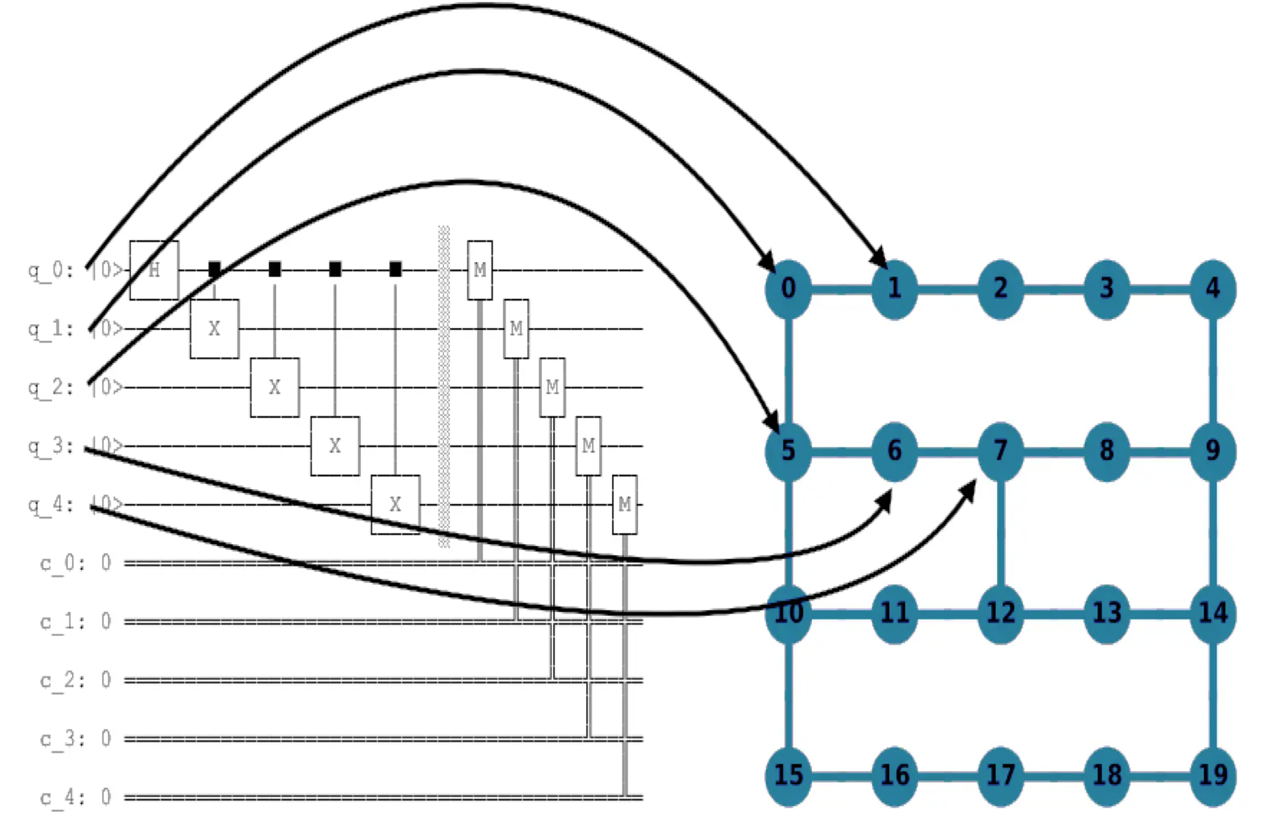
Layout Stage

Slide 34
Layout stage
Let's check which tasks will be enabled by which optimization_level
list_stage_plugins("layout")
print("Plugins run by default layout stage") print("=================================") for i in range(4): print(f"\nOptimization level {i}:") pm = generate_preset_pass_manager(backend=backend, optimization_level=i, layout_method='default', seed_transpiler=seed) qc_tr = pm.run(qc) for controller_group in pm.layout.to_flow_controller().tasks: tasks = getattr(controller_group, "tasks", []) for task in tasks: print(" - " , str(type(task).__name__)) print(qc_tr.layout.final_index_layout()) display(plot_circuit_layout(pm.run(qc), backend))

Slide 35
Layout stage
let's compare the score and layout of each option with optimization_level=3.
for option in list_stage_plugins("layout"): pm = generate_preset_pass_manager(backend=backend, optimization_level=3, layout_method=option, seed_transpiler=seed) qc_tr = pm.run(qc) score = scoring(qc_tr, backend) print(f"Layout method = {option}") print(f"Score: {score}") print(f"Layout: {qc_tr.layout.final_index_layout()}\n")

Slide 36
Routing stage
Routing stage inserts the appropriate amount of SWAP gates in order to execute the circuits using the selected layout. SWAP gates are expensive and noisy, so minimizing their number is crucial.
SWAP Mapping -
NP-hard Problem: Finding the optimal SWAP mapping is computationally expensive.
SabreSwap Algorithm: A stochastic heuristic used to find a good but not necessarily optimal SWAP mapping.
Repeated runs may generate different circuits, so users choose to run the routing function (or the entire StagedPassManager) many times and select the lowest-depth circuits from the distribution of outputs.

Slide 37
Routing stage
list_stage_plugins("routing") print("Number of each gates of transpiled circuit and the score") print("=================================") for i in range(4): print(f"\nOptimization level {i}:") pm = generate_preset_pass_manager(backend=backend, optimization_level=i, routing_method='basic', seed_transpiler=seed) qc_tr = pm.run(qc) score = scoring(qc_tr, backend) for key, value in qc_tr.count_ops().items(): print(key, ":", value) print(f"Score: {score}")
print("Plugins run by basic routing stage") print("=================================") for i in range(4): print(f"\nOptimization level {i}:") pm = generate_preset_pass_manager(backend=backend, optimization_level=i, routing_method='basic', seed_transpiler=seed) for controller_group in pm.routing.to_flow_controller().tasks: tasks = getattr(controller_group, "tasks", []) for task in tasks: print(" - " , str(type(task).__name__)) display(pm.routing.draw()) print(pm.run(qc).layout.final_index_layout())

Slide 38
Routing stage
## process stopped due to lookahead options = ['basic','sabre', 'stochastic'] for option in options: print(f"Layout option = {option}:") pm = generate_preset_pass_manager(backend=backend, optimization_level=3, routing_method=option, seed_transpiler=seed) qc_tr = pm.run(qc) score = scoring(qc_tr, backend) print(f"Score: {score}") for key, value in qc_tr.count_ops().items(): print(key, ":", value) print("\n")

Slide 39
Translation stage
Most quantum devices only natively support a handful of quantum gate and non-gate operations. These native gates are part of the definition of a target's ISA and this stage of the preset PassManagers translates the gates specified in a circuit to the native basis gates of a specified backend. This increases circuit depth and gate count.
Special Cases-
If a SWAP gate is not a native gate to the target backend, this requires three CNOT gates.
A Toffoli or controlled-controlled-not gate (ccx), is a three-qubit gate. For every Toffoli gate in a quantum circuit, the hardware may execute up to six CNOT gates and a handful of single-qubit gates.

Slide 40
Translation stage
Let's count the total gate numbers, circuit depth, and scores of transpiled circuits with the default option ('translator') and each optimization level.
list_stage_plugins("translation") print("Number of each gates of transpiled circuit") print("=================================") for i in range(4): print(f"\nOptimization level {i}:") pm = generate_preset_pass_manager(backend=backend, optimization_level=i, translation_method='translator', seed_transpiler=seed) qc_tr = pm.run(qc) score = scoring(qc_tr, backend) for key, value in qc_tr.count_ops().items(): print(key, ":", value) print(f"Score: {score}")

Slide 41
Translation stage
options = ['translator', 'synthesis'] print("Number of each gates of transpiled circuit") print("=================================") for option in options: print(f"Layout option = {option}:") pm = generate_preset_pass_manager(backend=backend, optimization_level=3, translation_method=option, seed_transpiler=seed) qc_tr = pm.run(qc) score = scoring(qc_tr, backend) for key, value in qc_tr.count_ops().items(): print(key, ":", value) print(f"Score: {score}") print("\n")

Slide 42
Translation stage
Let's plot it on a graph.
tr_depths = [] tr_gate_counts = [] tr_scores = [] options = ['translator', 'synthesis'] for i in range(4): for option in options: pm = generate_preset_pass_manager(backend=backend, optimization_level=i, translation_method=option, seed_transpiler=seed) tr_depths.append(pm.run(qc).depth()) tr_gate_counts.append(sum(pm.run(qc).count_ops().values())) tr_scores.append(scoring(pm.run(qc), backend))

Slide 43
Translation stage
colors = ['#FF6666', '#66B2FF'] markers = [ '^', '*'] linestyles = ['-.', ':'] opt_list = [] for i in range(4): opt_list.append(f"Optimization Level {i}") ax = opt_list fig, (ax1, ax2, ax3) = plt.subplots(3, 1, figsize=(10, 12)) # Plot 1: Circuit Depth for i in range(2): ax1.plot(ax, tr_depths[i::2], label=options[i], marker=markers[i], markersize=9, linestyle=linestyles[i], color=colors[i], linewidth=2) ax1.set_xlabel("translation options", fontsize=12) ax1.set_ylabel("Depth", fontsize=12) ax1.set_title("Circuit Depth of Transpiled Circuit", fontsize=14) ax1.legend(fontsize=10)

Slide 44
Translation stage
# Plot 2: Total Number of Gates for i in range(2): ax2.plot(ax, tr_gate_counts[i::2], label=options[i], marker=markers[i], markersize=9, linestyle=linestyles[i], color=colors[i], linewidth=2) ax2.set_xlabel("translation options", fontsize=12) ax2.set_ylabel("# of Total Gates", fontsize=12) ax2.set_title("Total Number of Gates of Transpiled Circuit", fontsize=14) ax2.legend(fontsize=10) # Plot 3: Score of Transpiled Circuit for i in range(2): ax3.plot(ax, tr_scores[i::2], label=options[i], marker=markers[i],markersize=9, linestyle=linestyles[i], color=colors[i], linewidth=2) ax3.set_xlabel("translation options", fontsize=12) ax3.set_ylabel("Score of Transpiled Circuit", fontsize=12) ax3.set_title("Score of Transpiled Circuit", fontsize=14) ax3.legend(fontsize=10) fig.tight_layout() plt.show()

Slide 45
Exercise 3
Your Task:At this point, you should feel like a professional at constructing different pass managers. Please make a pass manager with the following options:
1. optimization level = 3
2. "sabre" layout
3. "sabre" routing
4. "synthesis" translation
pm_ex3 = generate_preset_pass_manager ( backend=backend, ### Write your code below here ### ### Don't change any code past this line ### )
# Submit your answer using following code grade_lab3_ex3(pm_ex3)

Slide 46
Ecosystem and Qiskit Transpiler plugin
To facilitate the development and reuse of custom transpilation code by the wider community of Qiskit users, the Qiskit SDK supports a plugin interface that enables third-party Python packages to declare that they provide extended transpilation functionality accessible via Qiskit.
A transpiler stage plugin- Provides a pass manager that can be used in place of one of the six stages of a preset staged pass manager.
A unitary synthesis plugin- Provides extended functionality for unitary gate synthesis.
A high-level synthesis plugin- Provides extended functionality for synthesizing "high-level objects" such as linear functions or Clifford operators. High-level objects are represented by subclasses of the Operation class.

Slide 47
Thank you!

